Slide 1

Power in your hand is unlimited
Group 4 Gesture Recognition

Slide 2
Have you ever thought about …

Slide 3

Our creativity might be hindered from peripheral around us

Slide 4

Like a painter They only need few handy tools to make huge heady works

Slide 5


Do we really need this?

Slide 6

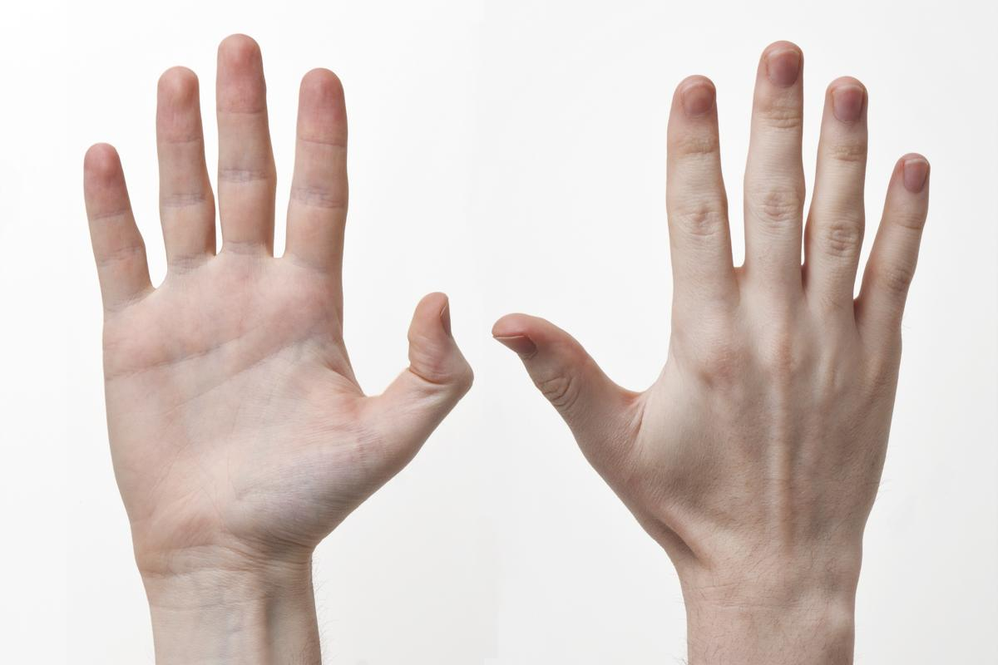
How about replacing partial PC function with bare hands

Slide 7

Operating a computer with hand gesture is no longer an imagination

Slide 8

What are we aiming at?
Gesture recognition
Gesture controlled Mouse
Gesture controlled Keyboard
GUI monitoring system

Slide 9






Framework
Data Collection
Training Data
Gesture Recognition
Operating System
GUI Monitor
Notes:
準確度高不一定代表姿勢判斷正確

Slide 10

Data Collection
Absolute coordinates
21 key point coordinates
Wrist (561,465)
Training Data
Gesture Recognition
Operating System
GUI Monitor
Notes:
在電腦眼裡的樣子

Slide 11
Data Collection
Wrist (561,465)
Convert to relative coordinated from ID:0
21 key point coordinates
all minus (561, 465)
Wrist (561, 465) convert to
(0, 0)
Training Data
Gesture Recognition
Operating System
GUI Monitor
Notes:
在電腦眼裡的樣子

Slide 12
Data Collection
Relative coordinates
Origin
(0, 0)
Training Data
Gesture Recognition
Operating System
GUI Monitor
Notes:
在電腦眼裡的樣子

Slide 13
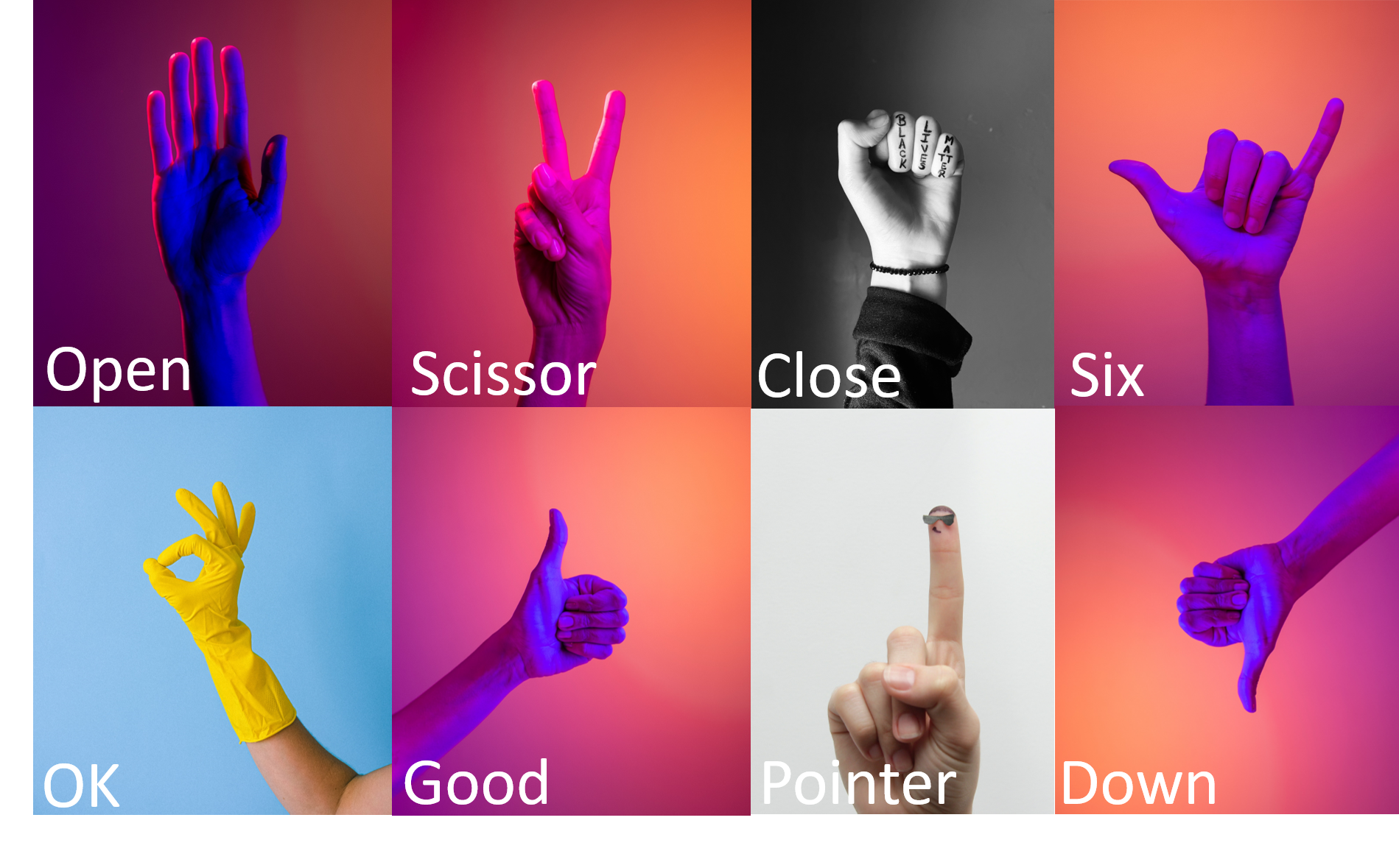
Data Collection
Training Data
Gesture Recognition
Operating System
GUI Monitor
Notes:
還有None

Slide 14

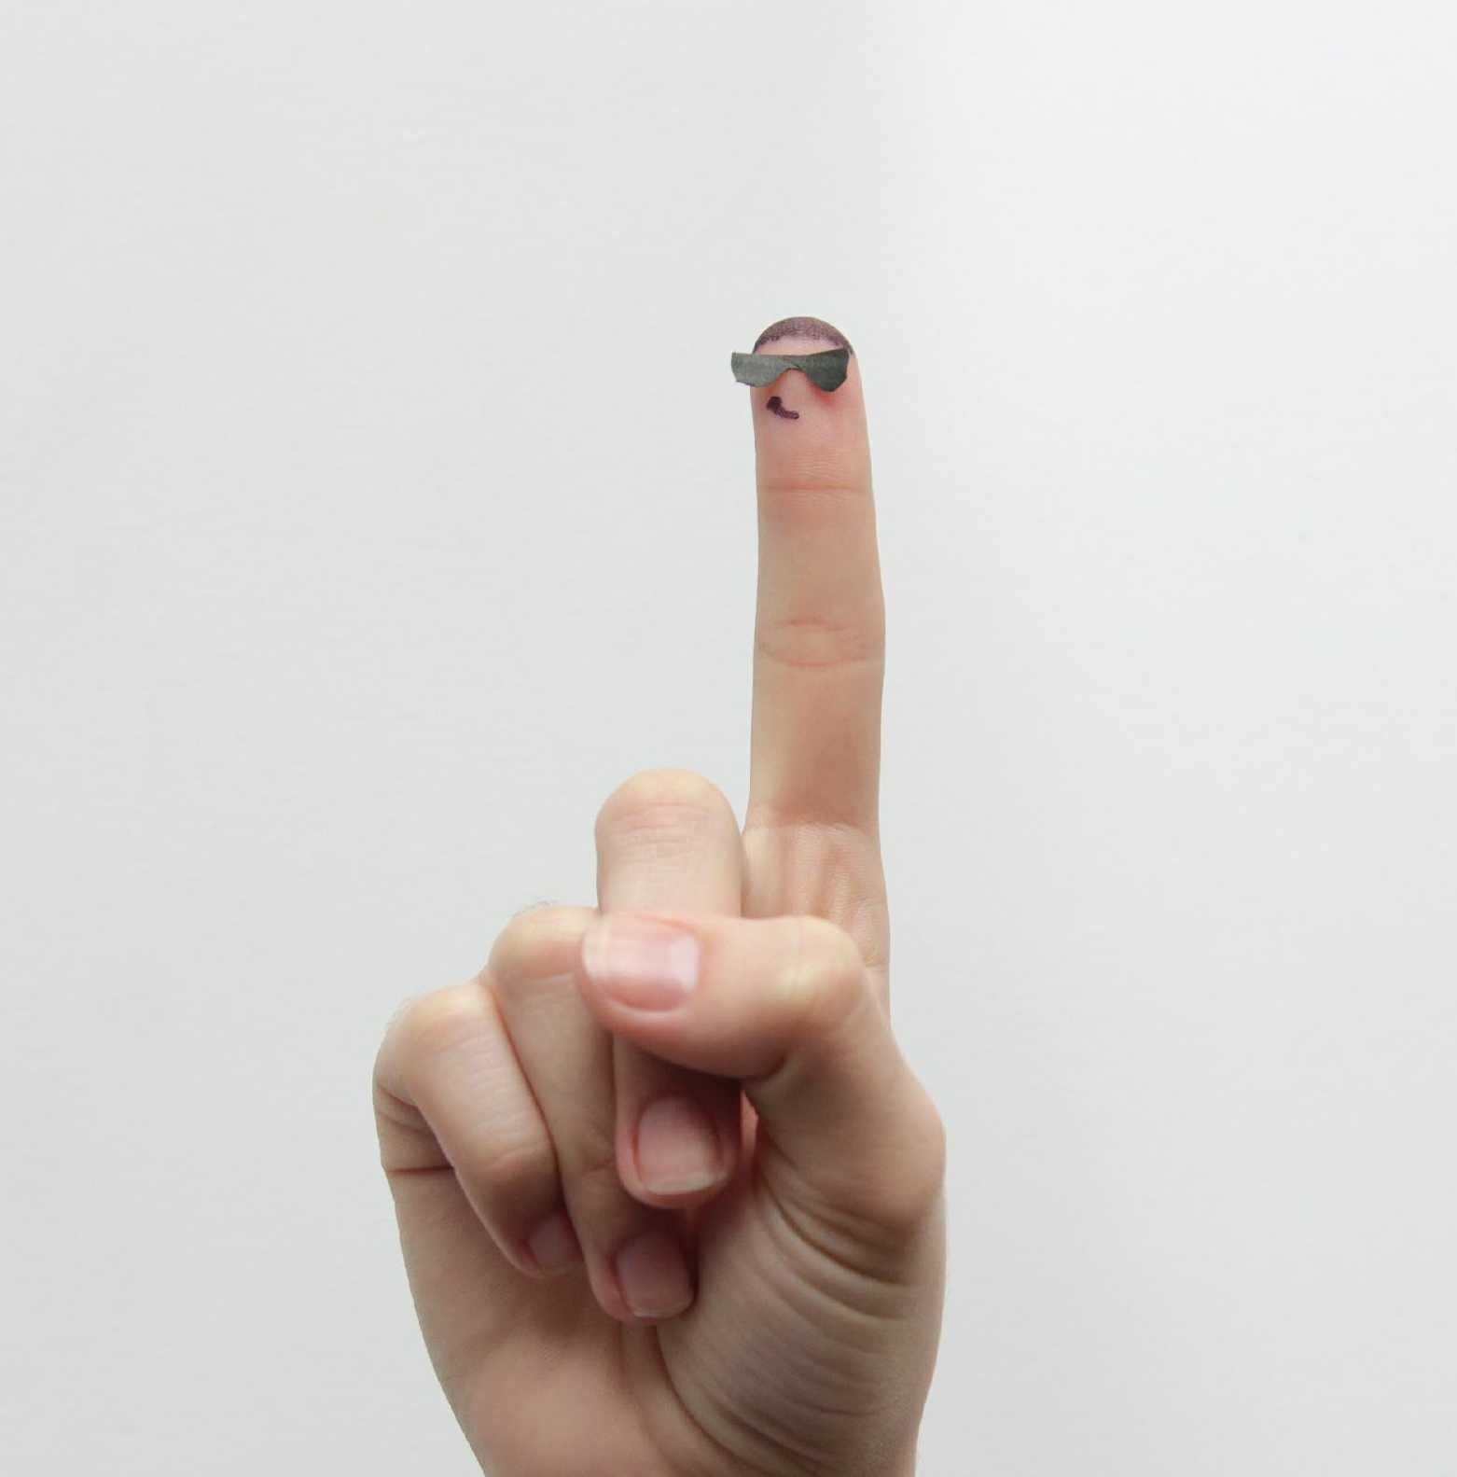

Data Collection
[550, 165]
Clockwise Spin
Counterclockwise Spin
Moving
Training Data
Gesture Recognition
Operating System
GUI Monitor
Notes:
在電腦眼裡的樣子

Slide 15
Data Collection
Clockwise Spin
(Time series coordinates)
T-15
T-14
T-13
…
T-02
T-01
T
[526, 176]
[509, 188]
…
[644, 219]
[644, 196]
[642, 178]
[550, 165]
Convert to relative coordinates from T-15
T-15
T-14
T-13
…
T-02
T-01
T
[0, 0]
[-24, 11]
[-41,23]
…
[94, 54]
[94,31]
[92, 13]
Normalized to fit screen width and height
(X Divided by width and Y divided by height)
T-15
T-14
T-13
…
T-02
T-01
T
[0, 0]
[-0.025, 0.0204]
[-0.0427, 0.0426]
…
[0.0979, -0.1]
[0.0979, -0.0574]
[-0.0958, -0.024]
Training Data
Gesture Recognition
Operating System
GUI Monitor
Counterclockwise Spin
Move
Notes:
在電腦眼裡的樣子

Slide 16

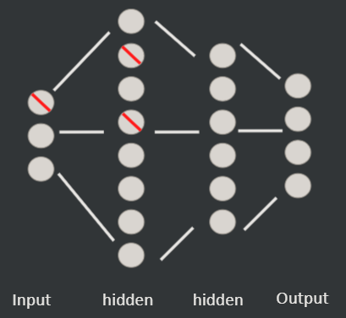
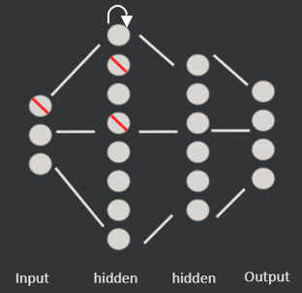
Training Data
Static gesture model
: NN model 1&2
Dynamic gesture model
: LSTM model
Gesture Recognition
Operating System
GUI Monitor
Data Collection
Clockwise Spin
Counterclockwise Spin
Move
Notes:
在電腦眼裡的樣子
nn 20,10,9
lstm 16,10,4

Slide 17

30000+ Training Data
Training Data
Gesture Recognition
Operating System
GUI Monitor
Data Collection
Static gesture model
Dynamic gesture model

Slide 18
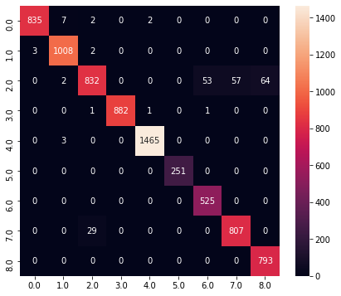
Confusion matrix
Training Data
Gesture Recognition
Operating System
GUI Monitor
Data Collection
Static gesture model
Dynamic gesture model

Slide 19
Accuracy: 97%
Training Data
Gesture Recognition
Operating System
GUI Monitor
Data Collection
Static gesture model
Dynamic gesture model
Notes:
Accuracy = f1 score average
兩個模型同時納入平均

Slide 20
5000+ Training Data
Training Data
Gesture Recognition
Operating System
GUI Monitor
Data Collection
Dynamic gesture model
Static gesture model

Slide 21
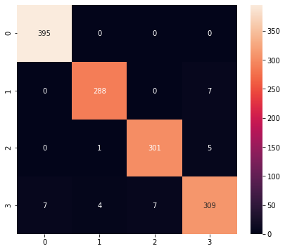
Confusion matrix
Training Data
Gesture Recognition
Operating System
GUI Monitor
Data Collection
Dynamic gesture model
Static gesture model

Slide 22
Accuracy: 98%
Training Data
Gesture Recognition
Operating System
GUI Monitor
Data Collection
Dynamic gesture model
Static gesture model

Slide 23
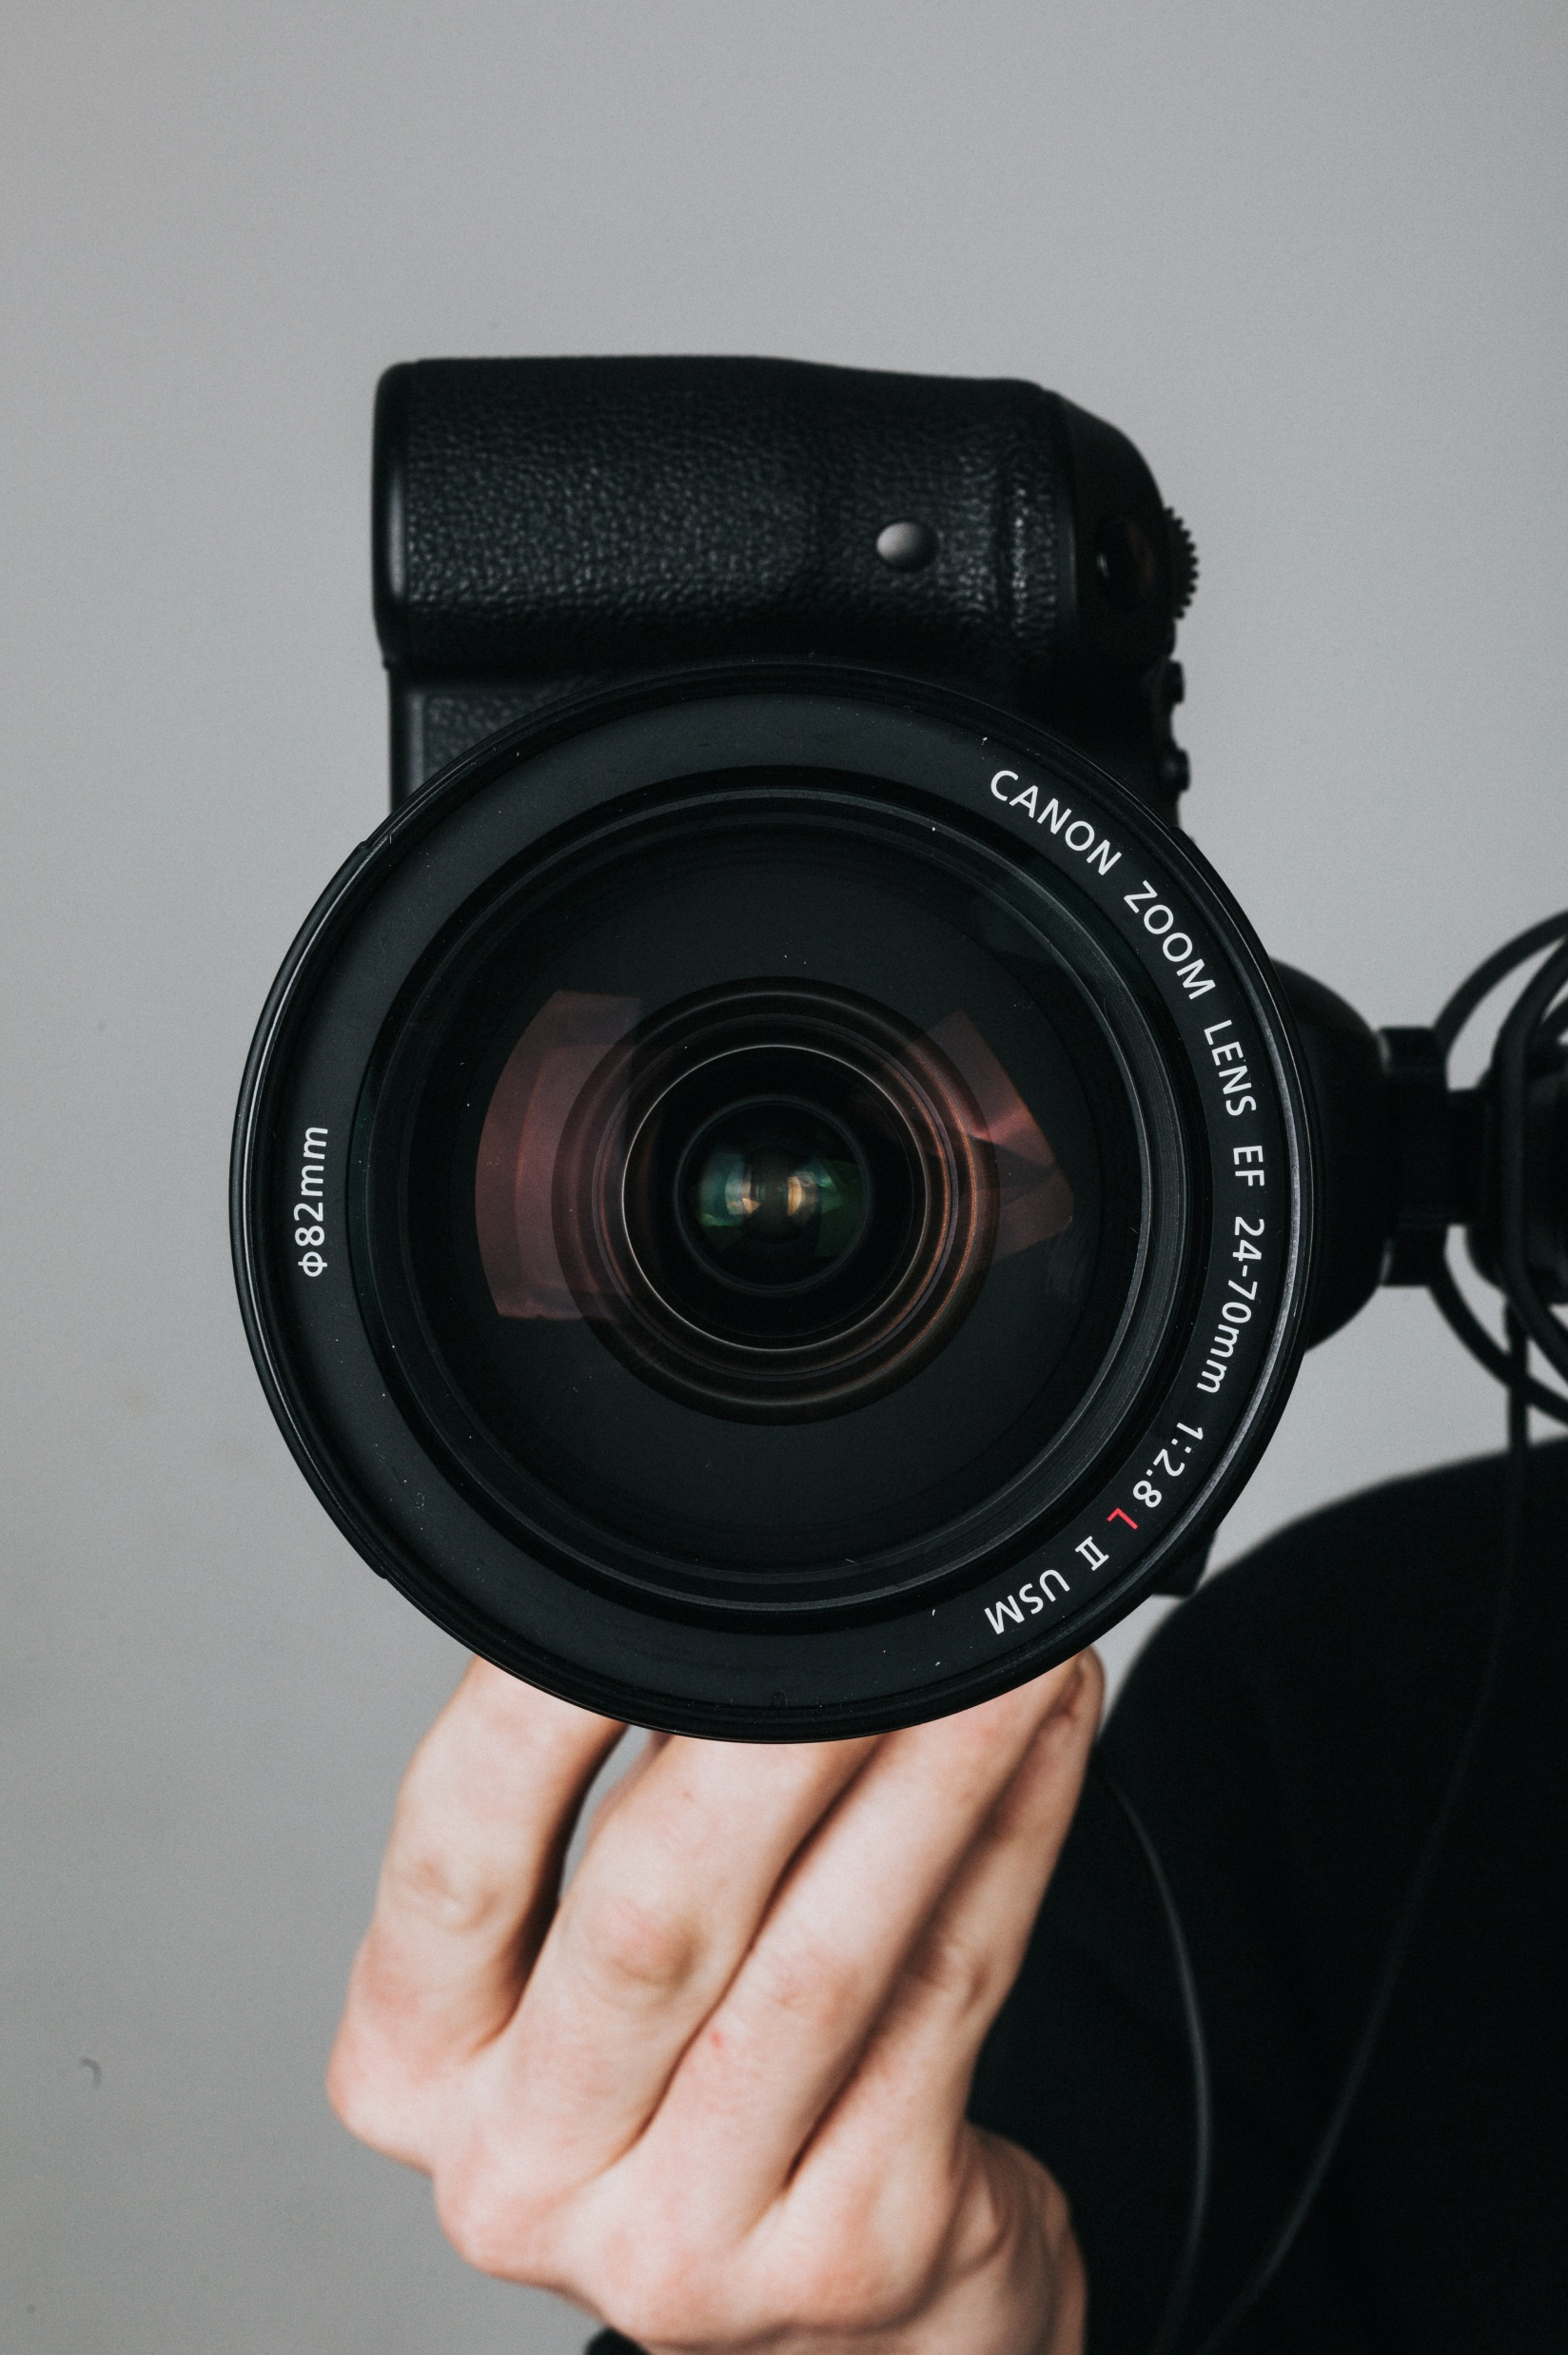
Gesture Recognition
How do they see you?
Operating System
GUI Monitor
Data Collection
Training Data

Slide 24


Gesture Recognition
Record all the images frame by frame
Operating System
GUI Monitor
Data Collection
Training Data

Slide 25

Gesture Recognition
Detect your hand
Operating System
GUI Monitor
Data Collection
Training Data

Slide 26
Gesture Recognition
(-50, 50)
(50, 75)
(0, 0)
Analyze and digitize it
Operating System
GUI Monitor
Data Collection
Training Data

Slide 27
Gesture Recognition
ID:0
ID:1
ID:2
…
ID:20
(0, 0)
…
(-50, 50)
(50, 75)
…
(XX,YY)
Operating System
GUI Monitor
Data Collection
Training Data

Slide 28

Gesture Recognition
...
???????
???
#a3?hq
??????
Haa3%4
12412
$?
……
今天晚餐吃什麼?
??????
Open
Model
ID:0
…
ID:1
(0, 0)
ID:20
(-50, 50)
…
ID:2
(50, 75)
…
(XX,YY)
Operating System
GUI Monitor
Data Collection
Training Data

Slide 29
Gesture Recognition
Open
Open
Open
Model
ID:0
Open
Open
Operating System
GUI Monitor
Data Collection
Training Data

Slide 30
Gesture Recognition
Deque
0
1
2
3
4
Open
Open
Open
Open
Open
…
Operating System
GUI Monitor
Data Collection
Training Data
Notes:
記住這張圖

Slide 31
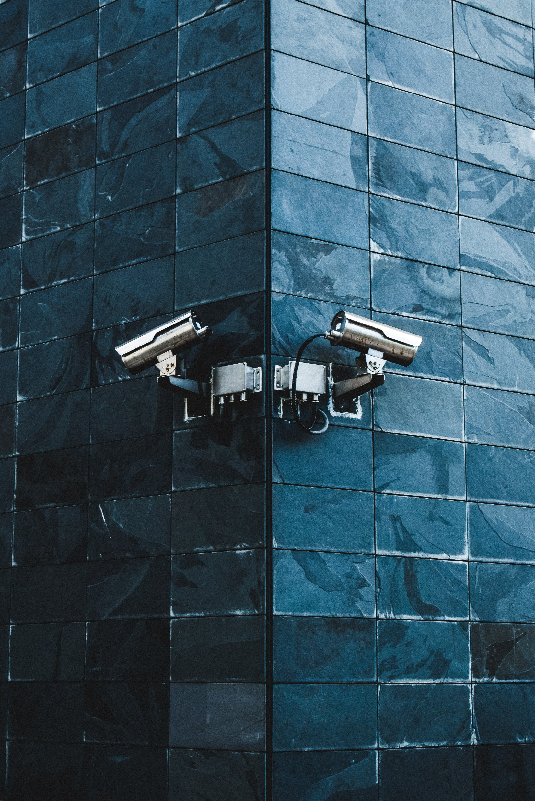
Gesture Recognition
Static
Dynamic
Operating System
GUI Monitor
Data Collection
Training Data

Slide 32
Static
Dynamic
Gesture Recognition
Model 1
LSTM Model
Model 2
Operating System
GUI Monitor
Data Collection
Training Data

Slide 33
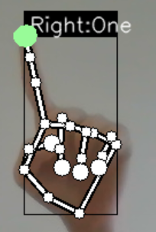
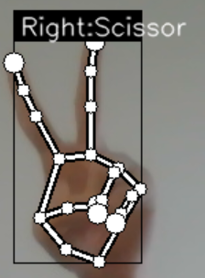
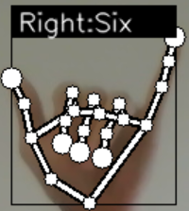
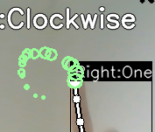
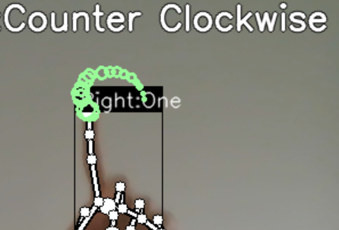
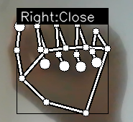
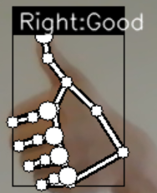
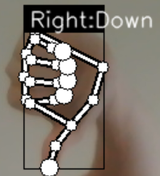
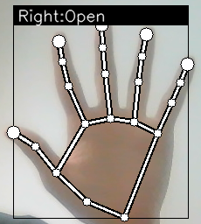
Static
Dynamic
Gesture Recognition
Model 1
LSTM Model
Model 2
None is all included
Operating System
GUI Monitor
Data Collection
Training Data

Slide 34
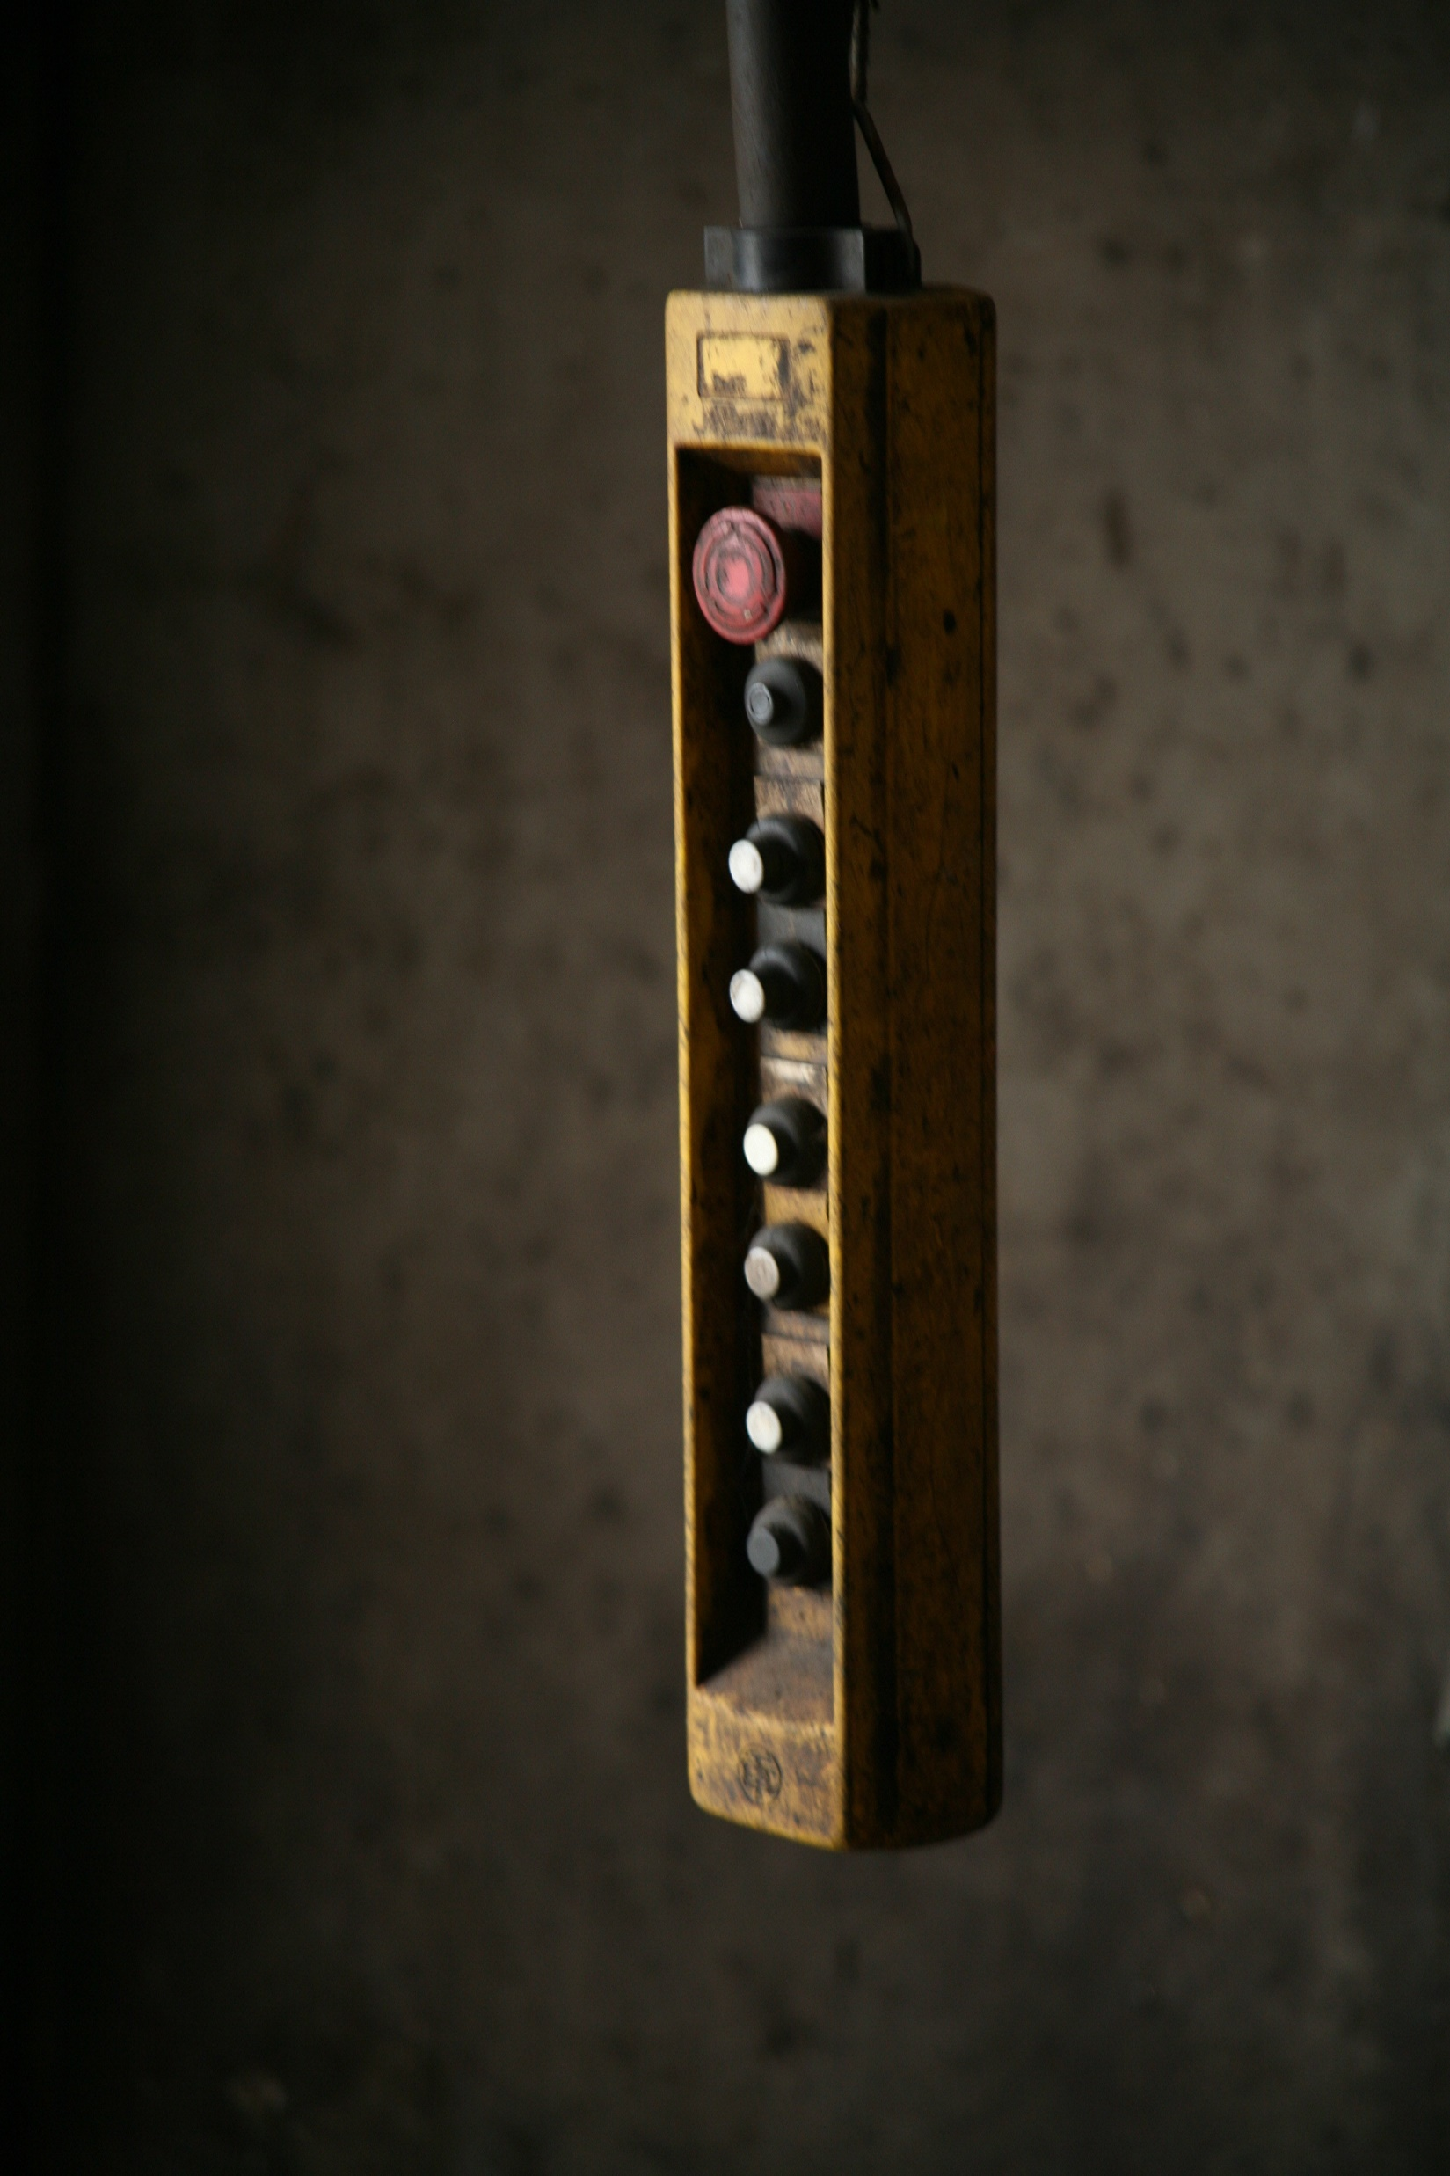
Close
Operating System
Gesture Recognition
Deque
Training Data
Data Collection
0
1
2
3
4
Open
Open
Open
Open
Open
…
GUI Monitor

Slide 35
OK
Operating System
Gesture Recognition
Deque
Training Data
Data Collection
0
1
2
3
4
Open
Open
Open
Open
Open
Close
…
GUI Monitor

Slide 36
Operating System
Gesture Recognition
Deque
Training Data
Data Collection
0
1
2
3
4
Open
Open
Open
Open
Close
OK
…
GUI Monitor

Slide 37




Six
Six
Six
Six
Six
Operating System
Gesture Recognition
0
1
2
3
4
Open
Open
Open
Close
OK
…
Training Data
0
1
2
3
4
Open
Open
Open
Close
OK
…
0
1
2
3
4
Data Collection
Open
Open
Open
Close
OK
…
0
1
2
3
4
Open
Open
Open
Close
OK
…
GUI Monitor

Slide 38
Six
Six
Six
Six
Six
Six
Operating System
Gesture Recognition
0
1
2
3
4
Open
Open
Open
Close
OK
Six
…
Training Data
0
1
2
3
4
Open
Open
Open
Close
OK
Six
…
0
1
2
3
4
Data Collection
Open
Open
Open
Close
OK
Six
…
0
1
2
3
4
Open
Open
Open
Close
OK
Six
…
GUI Monitor

Slide 39
Six
Six
Six
Six
Six
Six
Six
Six
Operating System
Gesture Recognition
0
1
2
3
4
Open
Open
Close
OK
Six
Six
…
Training Data
0
1
2
3
4
Open
Open
Close
OK
Six
Six
…
0
1
2
3
4
Data Collection
Open
Open
Close
OK
Six
Six
…
0
1
2
3
4
Open
Open
Close
OK
Six
Six
…
GUI Monitor

Slide 40
Six
Six
Six
Six
Six
Six
Six
Six
Operating System
Gesture Recognition
0
1
2
3
4
Six
Six
Six
Six
Six
…
Training Data
0
1
2
3
4
Six
Six
Six
Six
Six
…
0
1
2
3
4
Data Collection
Six
Six
Six
Six
Six
…
0
1
2
3
4
Six
Six
Six
Six
Six
…
GUI Monitor

Slide 41
Operating System
Gesture Recognition
Training Data
Data Collection
0
1
2
3
4
Six
Six
Six
Six
Six
…
GUI Monitor

Slide 42
Operating System
Gesture Recognition
Training Data
0
1
2
3
4
X 8
Six
Six
Six
Six
Six
…
Data Collection
Function: Changing
Mode
GUI Monitor

Slide 43



Operating System
Gesture Recognition
Mode
Training Data
Sleep
Mouse
Keyboard
Data Collection
GUI Monitor

Slide 44
Operating System
Gesture Recognition
Sleep
Mode
Training Data
NN Model1
Most common label1
Web Cam
Image
NN Model2
Most common label2
Data Collection
LSTM Model
Most common label3
GUI Monitor

Slide 45
Operating System
Gesture Recognition
Sleep
Mode
Training Data
Most common label1
NN Model1
Do nothing
Web Cam
Image
No
NN Model2
Most common label2
Is label six?
Data Collection
LSTM Model
Most common label3
Yes
Change mode
Sleep mode (auto turn on in 10 sec)
GUI Monitor

Slide 46
Operating System
Gesture Recognition
Mouse
Mode
Training Data
NN Model1
Most common label1
Web Cam
Image
NN Model2
Most common label2
Data Collection
LSTM Model
Most common label3
GUI Monitor

Slide 47
Operating System
Gesture Recognition
Mouse
Mode
Most common label1
One
Control mouse
Which label
Training Data
Scissor
NN Model1
Click
Web Cam
Image
Most common label2
Close
NN Model2
DoubleClick
Data Collection
Which label
LSTM Model
Most common label3
Six
Good
Down
OK
Change mode
Scroll up
Scroll down
Last page
GUI Monitor

Slide 48
Operating System
Gesture Recognition
Mouse
Mode
Training Data
NN Model1
Most common label1
Web Cam
Image
NN Model2
Most common label2
Data Collection
LSTM Model
Most common label3
GUI Monitor

Slide 49
Operating System
Gesture Recognition
Mouse
Mode
OK
Subtitle
Training Data
Most common label2
Which label
NN Model1
Most common label1
Up
Volume down
Web Cam
Image
Scissor
NN Model2
Most common label3
Down
Volume up
Pause &
Play
Data Collection
Six
Change mode
LSTM Model
Which label
Counter clockwise
Clockwise
Close
forward
5 s
Speed down
Speed up
Open
backward 5 s
GUI Monitor

Slide 50

GUI Monitor
Run
Mouse Mode
`
Run
Keyboard Mode
Run
Sleep Mode
Data Collection
Training Data
Gesture Recognition
Operating System

